Slide 1
Essential Activities
Note-taking, Mapping, Writer’s Block and Dialogue

Slide 2
Active Reading
It is essential to be able to read actively rather than passively – to be prepared to make connections, be able to extend the ideas you are presented with, and to be able to question those ideas. (Anderson, Babington, Lepan, and Okun 26)

Slide 3
What is Active Reading Exactly?
You should be processing the information you read by connecting it with things you already know.
If you are presented with information that you have never come across before, you should look at it analytically, meaning you should question whether or not it is true or trustworthy information.

Slide 4
Take Notes!
Thoughts and insights can strike at any time, but they also have a way of evaporating quickly – so it’s wise to be prepared…writing things down is essential to the writing process. (Anderson, Babington, Lepan, and Okun 28)

Slide 5
How Exactly?
Writing in the margins of the book (if it is your book)
Keeping a sheet of paper or notebook nearby to jot down ideas, thoughts, or pages containing important ideas or passages.
It is also useful to underline or highlight useful passages.

Slide 6
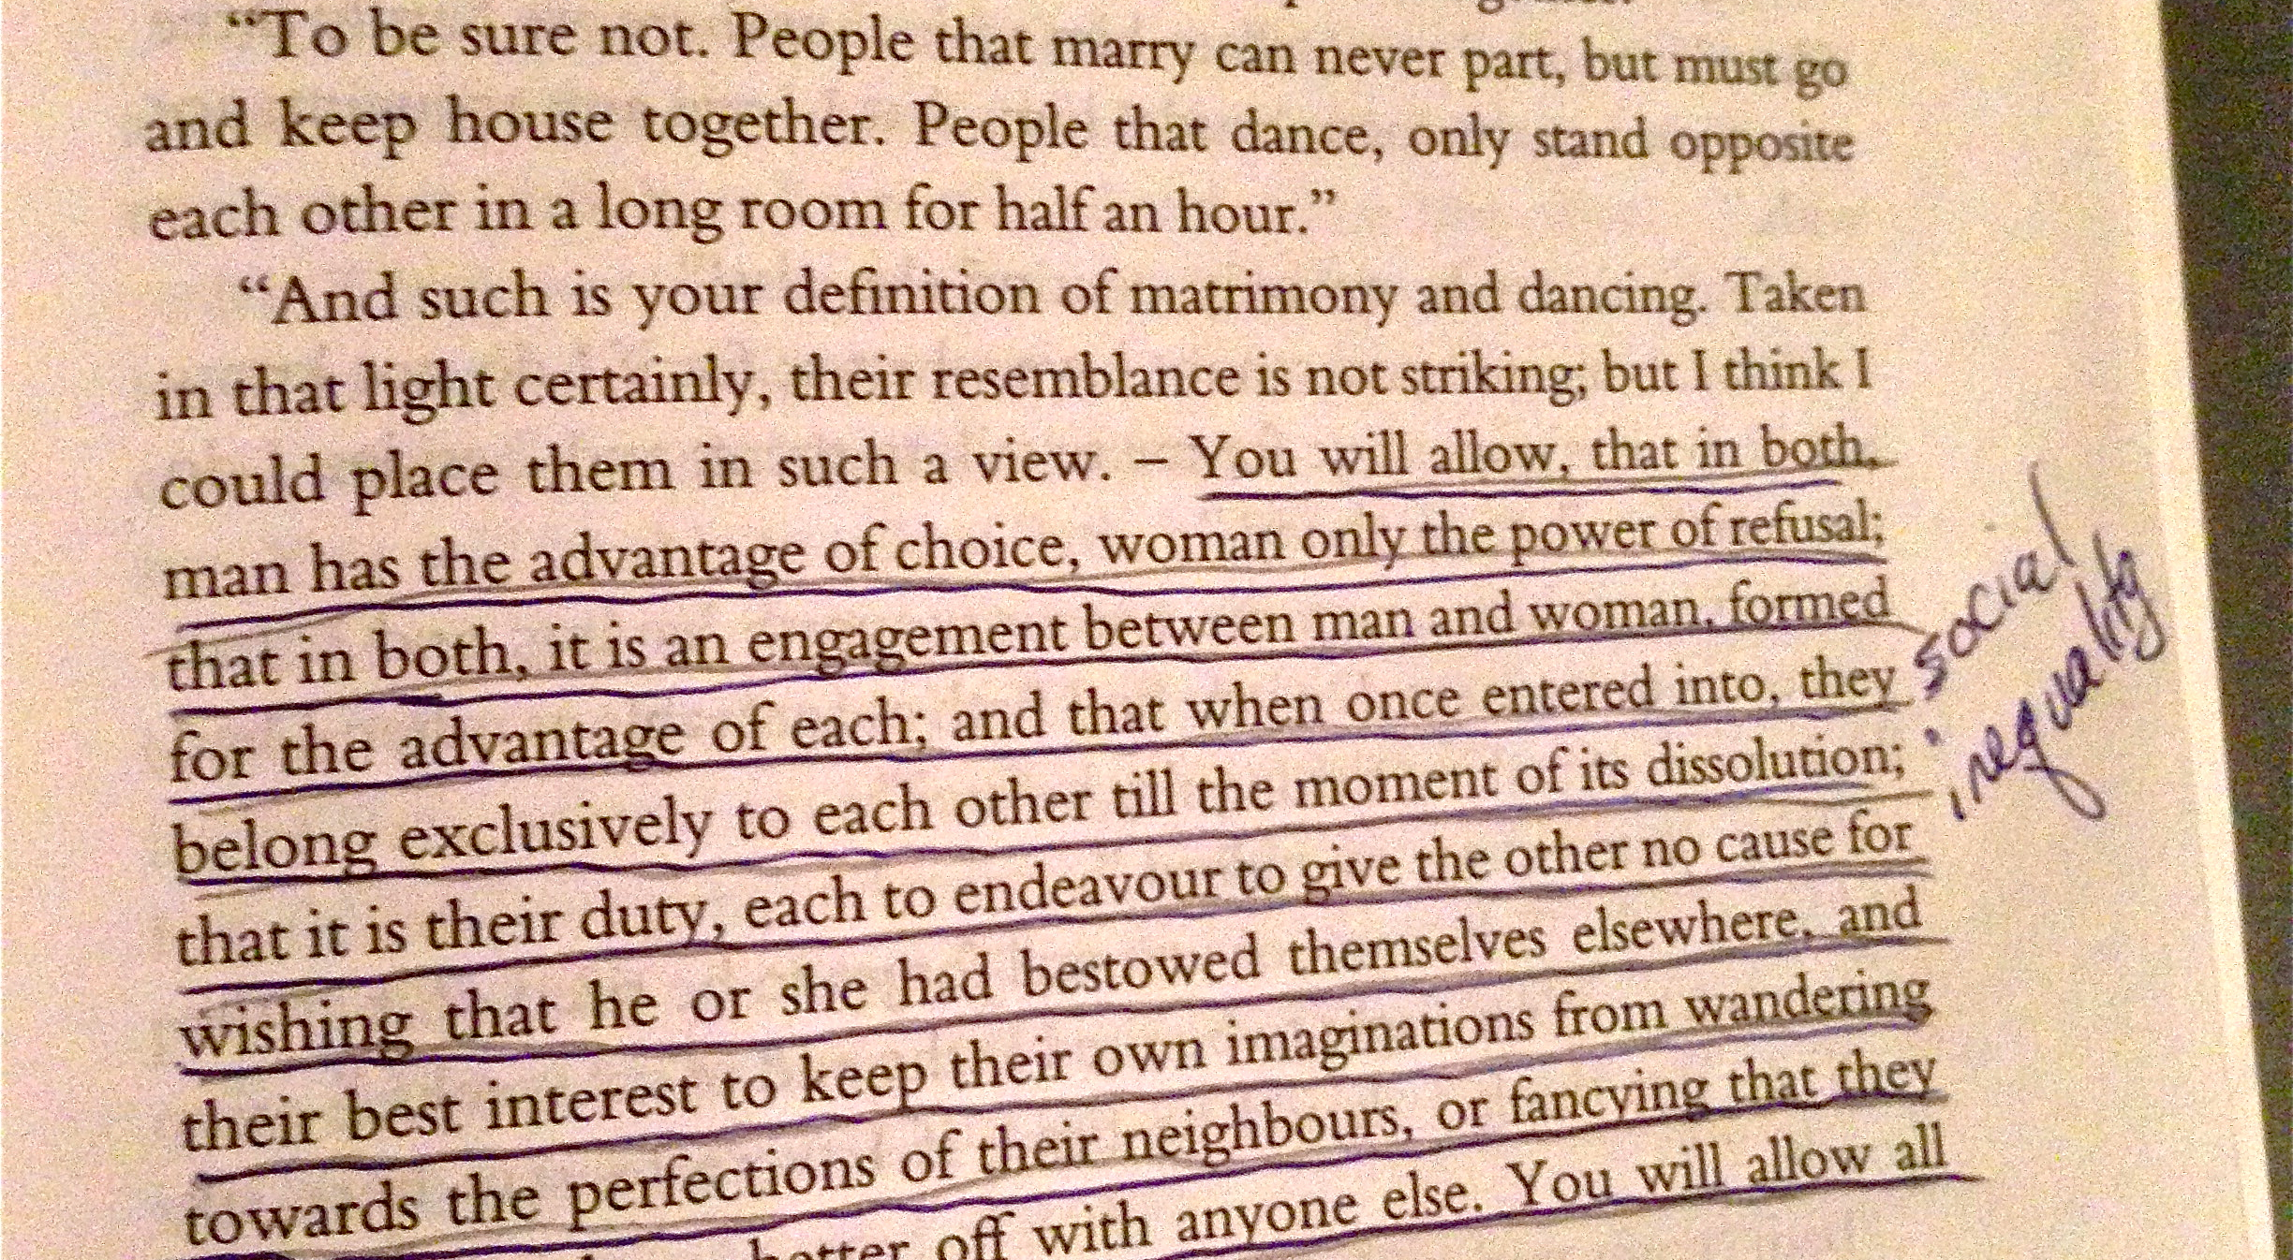
What does that look like?

Slide 7
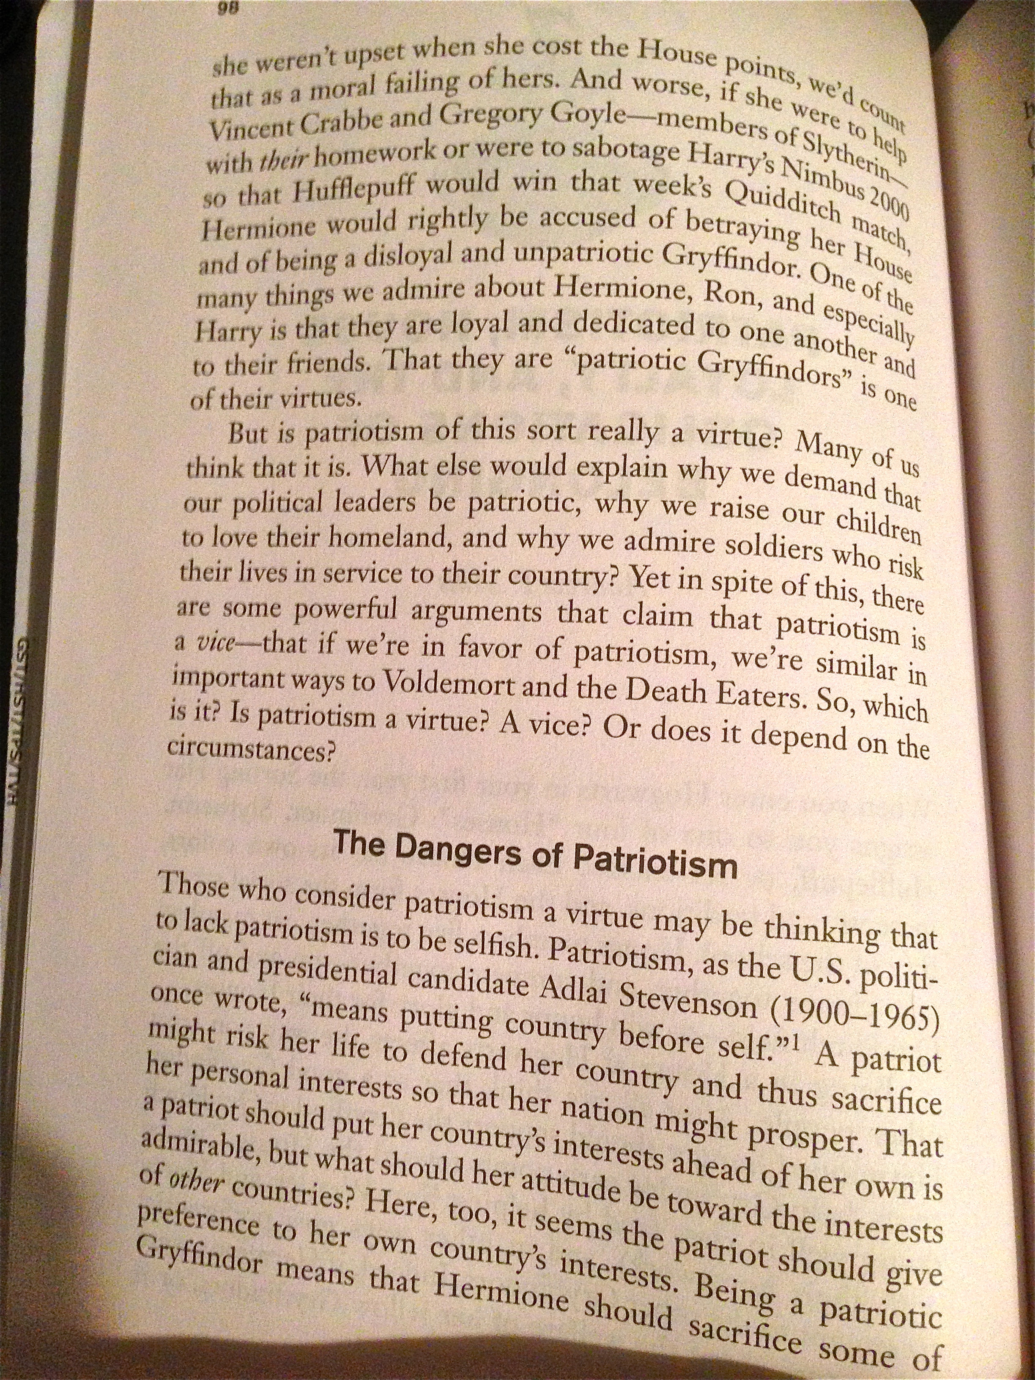
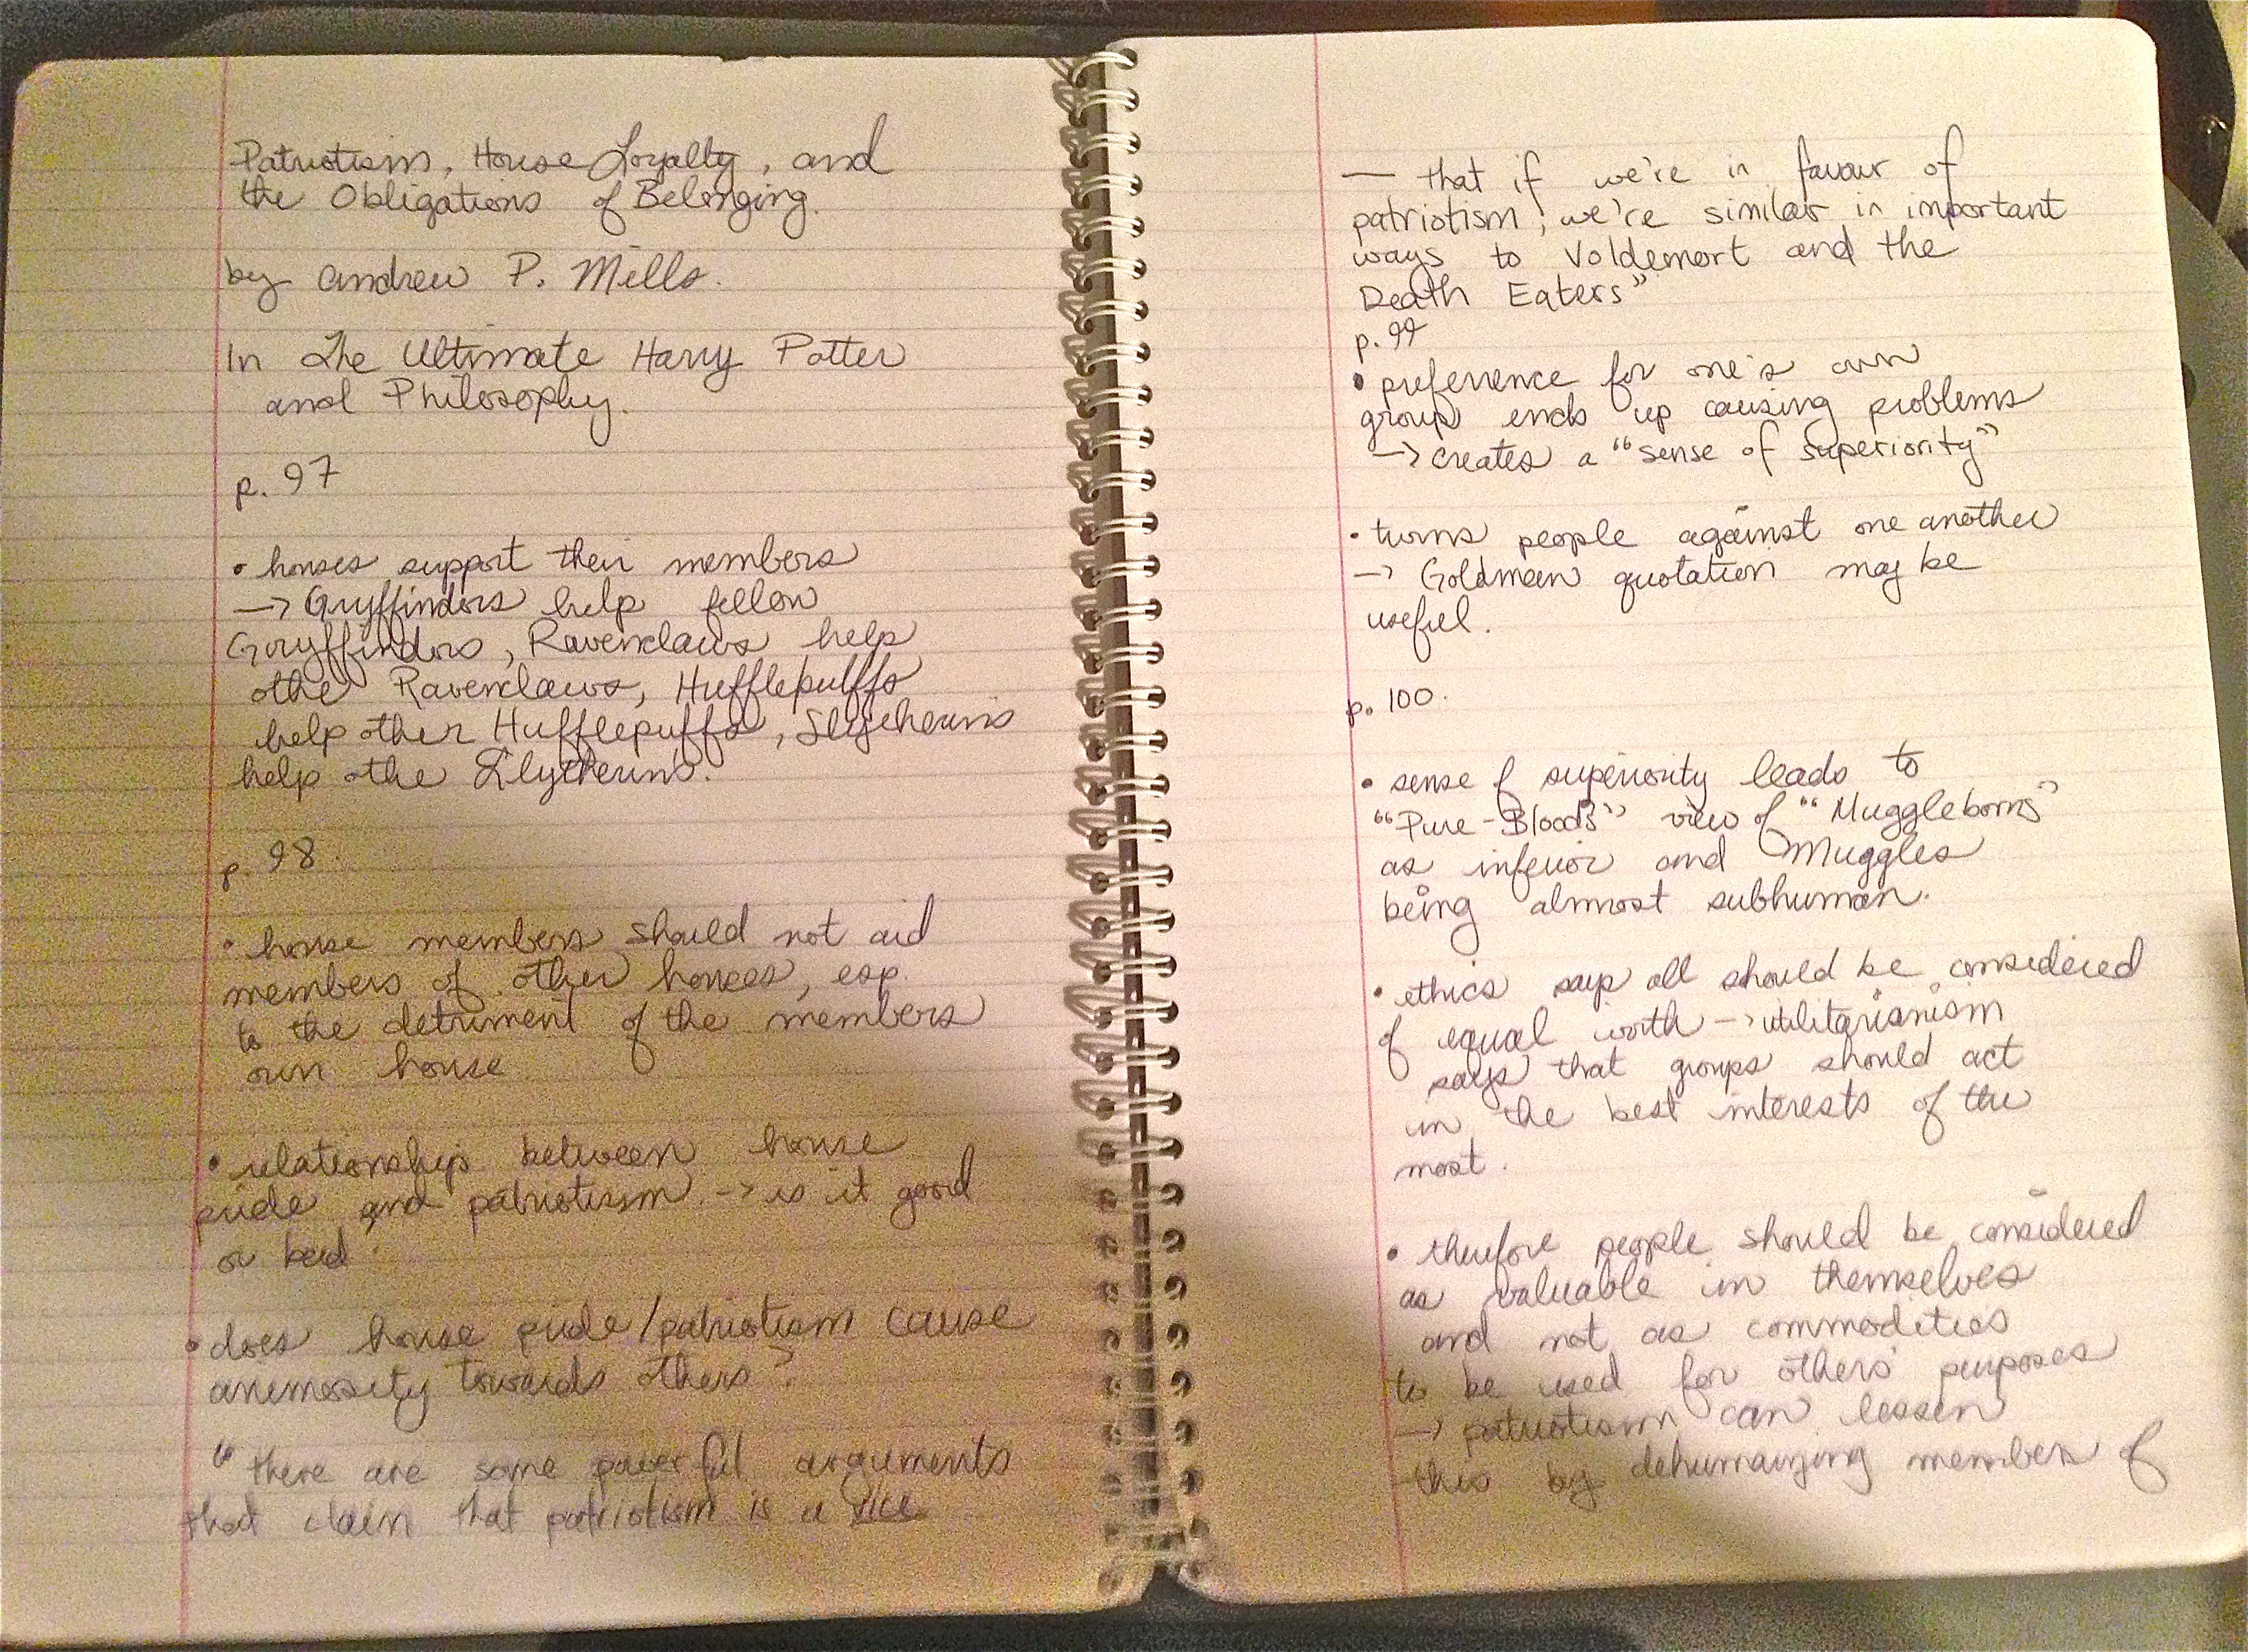
What does that look like?

Slide 8
Taking Notes in Class
If I put it in a PowerPoint, you don’t need to write it down – I will post it on UR Courses.
If I write it on the board, you should write it down – it is probably important!
You will never be able to write down everything I say in class; you need to figure out what is going to be most useful and write that down.

Slide 9
Mapping
Mapping is the beginning of you putting your thoughts and ideas into some kind of order.
You will likely notice certain concepts being repeated in your notes: these will likely become key concepts in your paper.
You should then try to figure out how these ideas intersect and affect one another in a rough way.

Slide 10
Mapping
Ofilis painting
Moral/Legal Issues
Aesthetic Issues
Artist’s Intentions

Slide 11
Melissa Davis’s Project
Freedom of Expression
Legal Issues
Constitution and other legal standards
Importance of Freedom of Speech, etc.
Moral Issues
Works considered offensive by some

Slide 12
Dumbledore as Guide
Dumbledore as Harry’s guide/mentor
Dumbledore is a good mentor
Allows Harry to discover things for himself and make mistakes
Dumbledore’s approach makes Harry more independent
Dumbledore is a bad mentor
Dumbledore puts Harry in too much danger

Slide 13
Dumbledore as Guide Version 2
Dumbledore is a good guide/mentor
Dumbledore allows Harry to deal with situations himself rather than stepping in to protect Harry
Dumbledore allows Harry to make his own decisions
Ultimately, Harry learns far more from this approach
Harry makes mistakes but learns from them
Harry is able to handle situations on his own rather than always seeking adult help

Slide 14
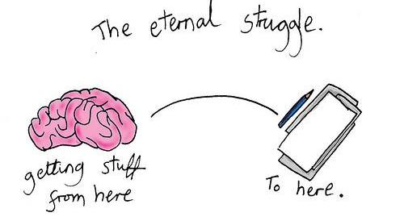
Writer’s Block

Slide 15
Why is Writing so Hard?
As every experienced writer knows, writing is not simply a process of putting down on paper what is already known in the writer’s mind. The very act of writing forces the writer, inevitably (but often quite unexpectedly), to see things differently, to combine ideas in unanticipated ways. (Anderson, Babington, Lepan, and Okun 32)

Slide 16
How to Avoid Writer’s Block?
Be Confident!
One of the things that plagues most writers is that their ideas are bad, or that they have nothing original to say.
If you feel this way, write anyway! It always looks different when it’s on the page.

Slide 17
How to Avoid Writer’s Block
Write Something! Write Anything!
Just force that pen to move across the paper (or those keyboard keys to start clicking), quite literally writing anything that comes to mind, whether coherent or not, whether on or off topic. After ten or fifteen minutes, usable material will have turned up. (Anderson, Babington, Lepan, and Okun 31)

Slide 18
How to Beat Writer’s Block
Realize that Writing is a Process.
• Your first draft will never be perfect, and you should not expect it to be perfect.
You can always change it later, and you will find that your ideas will change as you write.

Slide 19
Dialogue
It will help your writing if you try to think about others’ perspectives.
You can do this on your own, or you can ask someone to look at your work.
You can also discuss your topic with someone else to get ideas.

Slide 20
Dialogue
Too often we look at our own work as sacrosanct; we are embarrassed by its weaknesses, shy of showing it to others before it’s what we like to think of as perfect. And if at that late stage others see imperfections, we are too easily hurt. (Anderson, Babington, Lepan, and Okun 33)

Slide 21
Dialogue
You can find help in a variety of places: there are several writing centres on campus or you can seek help from friends and family whose opinions you trust.
However, do not become dependent on others to fix your mistakes for you; you should take that experience and learn to fix them yourself!

